Slide 1
CAPSTONE PROJECT
CUSTOMER SEGMENTATION
Team Members
ISHWARYA

Slide 2
CONTENT
BUSINESS UNDERSTANDING
DATA SUMMARY
FEATURE ANALYSIS
EXPLORATORY DATA ANALYSIS
DATA PREPROCESSING
IMPLEMENTING ALGORITHMS
CHALLENGES
CONCLUSIONS

Slide 3
BUSINESS UNDERSTANDING
Customer segmentation is the practice of dividing a company’s customers into groups that reﬂect similarity among customers in each group. The goal of segmenting customers is to decide how to relate to customers in each segment in order to maximize the value of each customer to the business.
Customer segmentation has the potential to allow marketers to address each customer in the most effective way. Using the large amount of data available on customers (and potential customers), a customer segmentation analysis allows marketers to identify discrete groups of customers with a high degree of accuracy based on demographic, behavioral and other indicators.
Given the dataset, the objective is to build a clustering model that would perform customer segmentation.

Slide 4
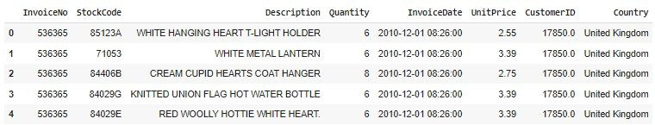
DATA SUMMARY
Total Rows : 541909
Total Column: 8
A transactional data set with transactions occurring between 1st December 2010 and 9th December 2011 for a UK-based online retailer.
Many customers of the company are wholesalers.

Slide 5
FEATURE SUMMARY
The contents of the data had features such as:
InvoiceNo: Invoice number. Nominal, a 6-digit integral number uniquely assigned to each transaction. If this code starts with letter 'c', it indicates a cancellation.
StockCode: Product (item) code. Nominal, a 5-digit integral number uniquely assigned to each distinct product.
Description: Product (item) name. Nominal.
Quantity: The quantities of each product (item) per transaction. Numeric.
InvoiceDate: Invoice Date and time. Numeric, the day and time when each transaction was generated.
Unit Price: Unit price. Numeric, Product price per unit in sterling.
CustomerID: Customer number. Nominal, a 5-digit integral number uniquely assigned to each customer. Country: Country name. Nominal, the name of the country where each customer resides.

Slide 6
INSIGHTS FROM OUR DATASET
This Dataset is from the UK
In our data set there are 541909 rows, 8 columns
Four categorical features ‘InvoiceNo’, ‘Stock Code’, & ‘Description’, ‘ Country’.
There are Missing Values present on Description & CustomerID columns, Removed null values
There are Duplicate values present, Removed duplicates
One Datetime[ns] features ‘InvoiceDate’.
Outliers present only in “Quantity” & “Unit Price”column.
Removed cancelled orders.
Added new features from datetime column such as months, days, hours.
Added Total Amount
Converted data types

Slide 7
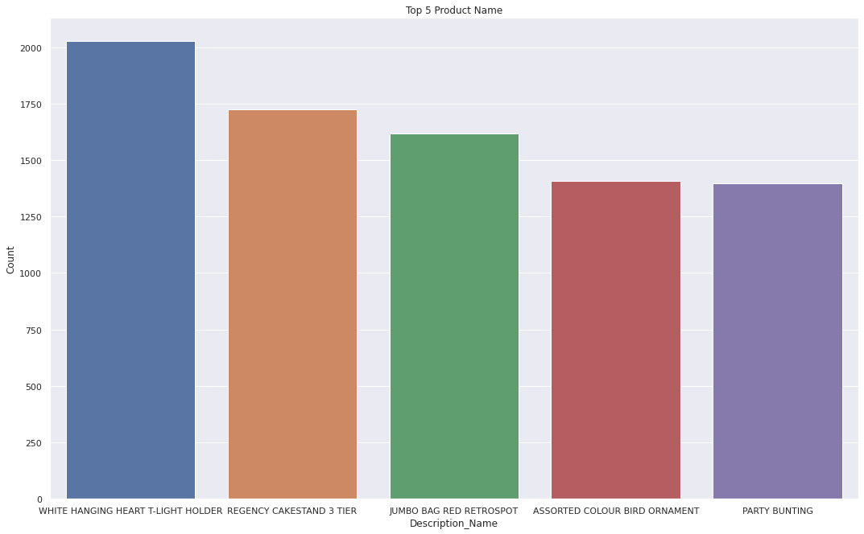
ANALYSIS ON TOP COMPANIES
1.WHITE HANGING HEART T-LIGHT HOLDER, 2.REGENCY CAKESTAND 3 TIER 3.JUMBO BAG RED RETROSPOT 4.PARTY BUNTING 5.LUNCH BAG RED RETROSHOP

Slide 8
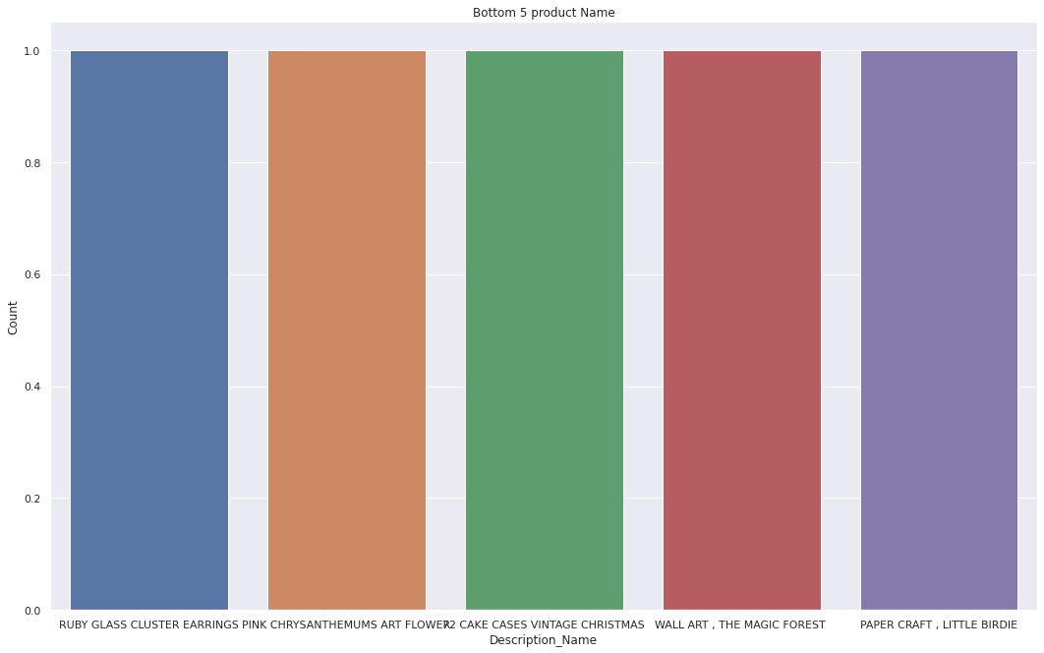
ANALYSIS ON BOTTOM COMPANIES
Top bottom products are
1.Light Decoration Battery Operated 2.Water damaged 3.throw away 4.re dotcom quick fix. 5.Birthday banner tape

Slide 9
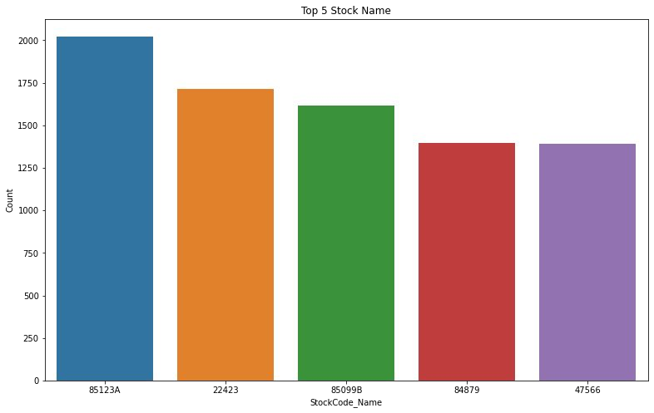
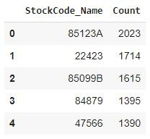
ANALYSIS ON STOCK CODE

Slide 10
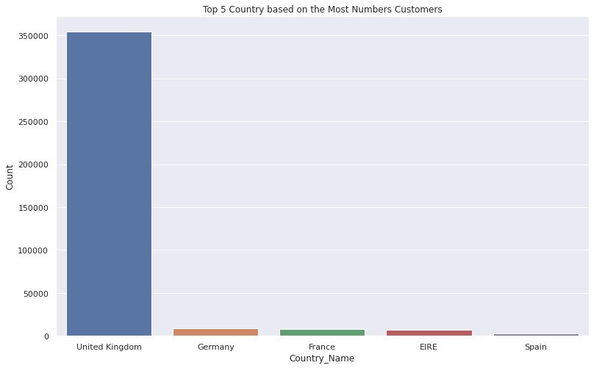
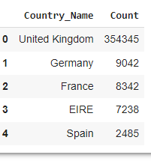
ANALYSIS ON COUNTRY BASED

Slide 11
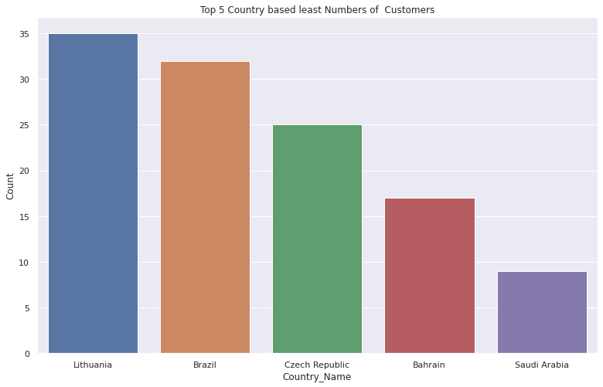
ANALYSIS LEAST COMPANY BASED
From this graph we can see that least number of customers from Lithuania, Brazil, Czech Republic ,Bahrain and Saudi Arabia

Slide 12
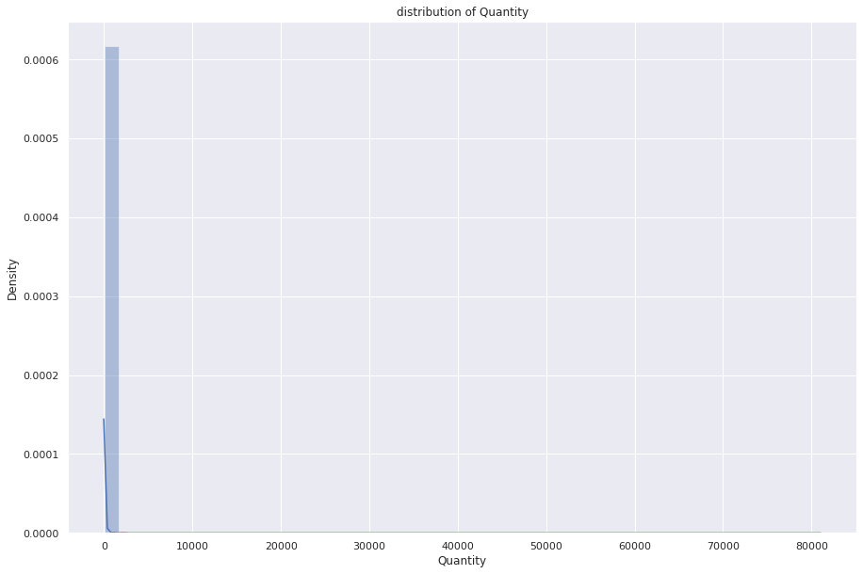
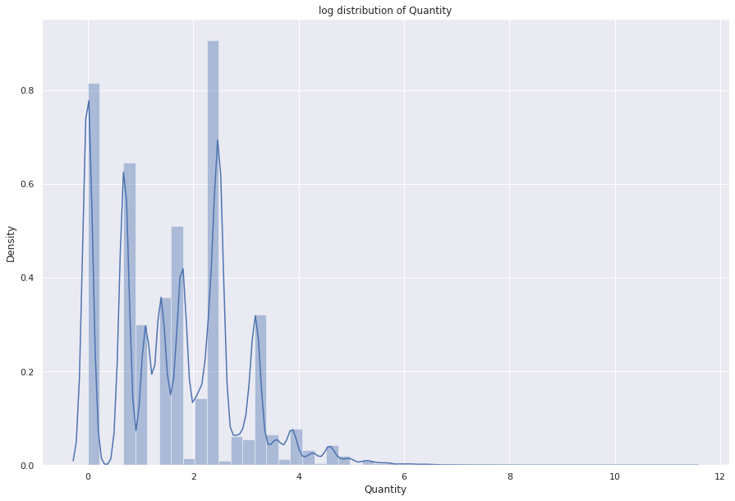
DISTRIBUTION
1.Positively skewed (or right-skewed) distribution is a type of distribution in which most values are clustered around the left tail of the distribution while the right tail of the distribution is longer.hear mean>median>mode
2. Negatively skewed (also known as left-skewed) distribution is a type of distribution in which more values are concentrated on the right side (tail) of the distribution graph while the left tail of the distribution graph is longer.hear mean<median<mode1

Slide 13
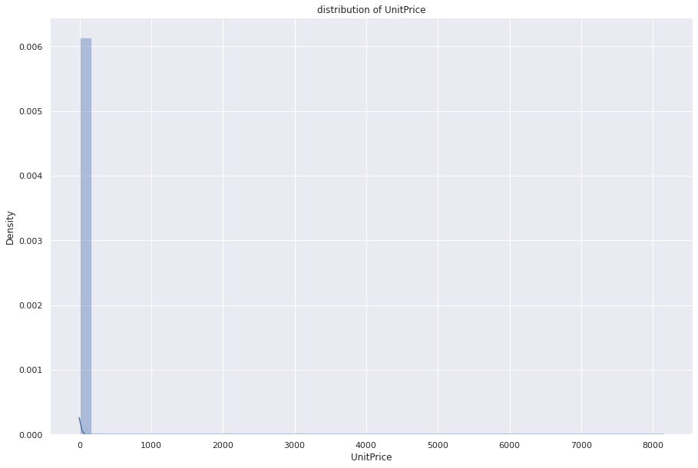
DISTRIBUTION
For symmetric graph mean=median=mode

Slide 14
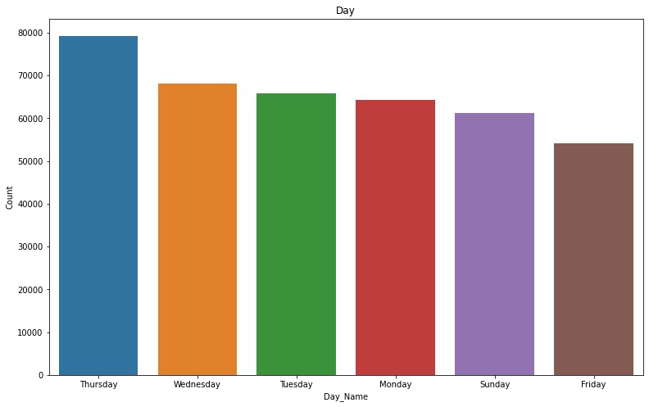
ANALYSIS DAY WISE
Most of the customers have purchased the items in Thursday, Wednesday and Tuesday

Slide 15
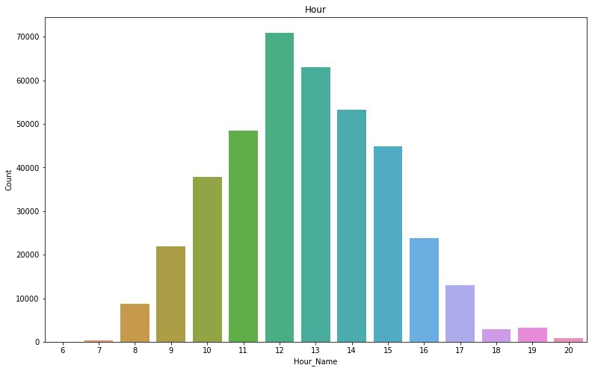
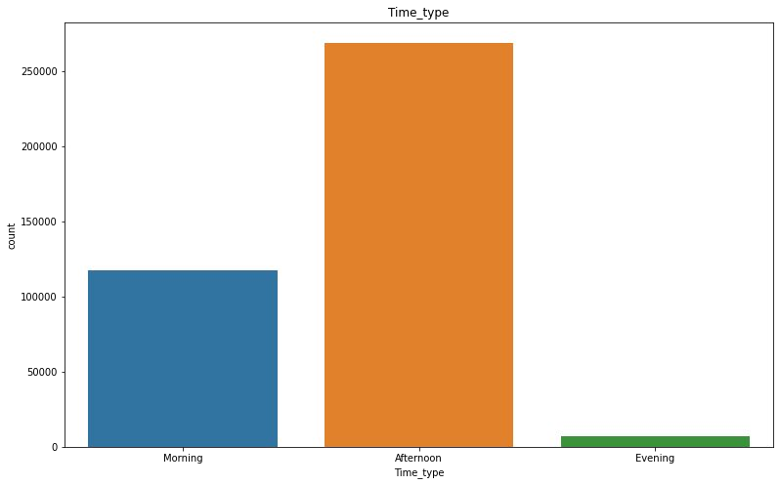
ANALYSIS HOUR WISE
Working hours witnessing the highest sales could be attributed to the fact that a large part of the dataset is Wholesalers’ data.

Slide 16
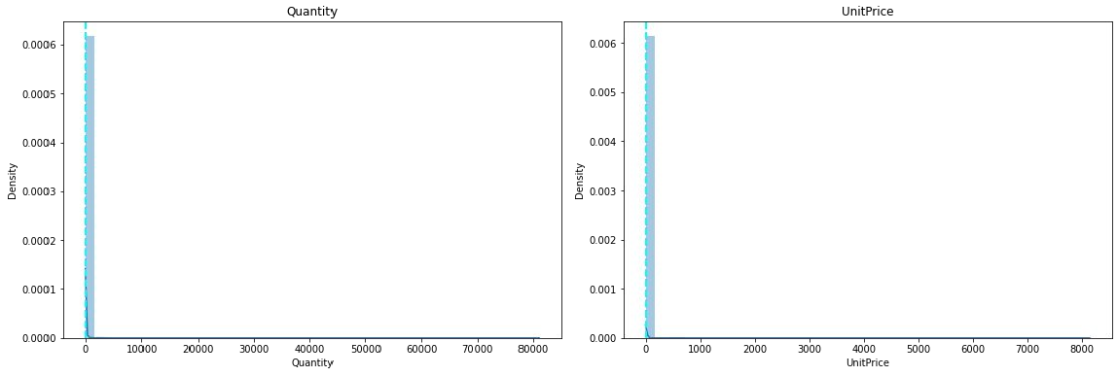
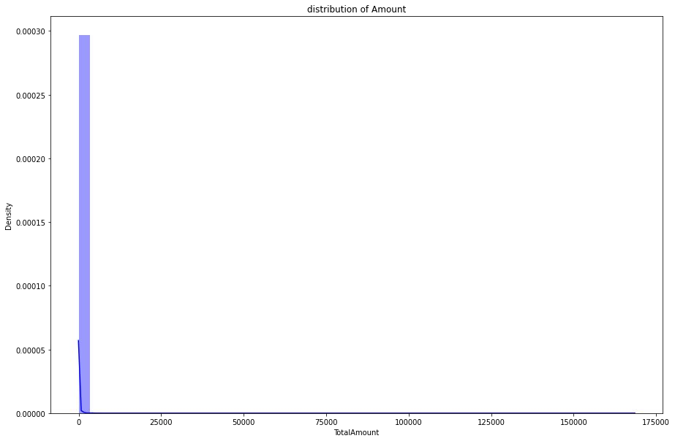
ANALYSIS NUMERICAL VARIABLE
Highly positively skewed, need to do log transformation

Slide 17
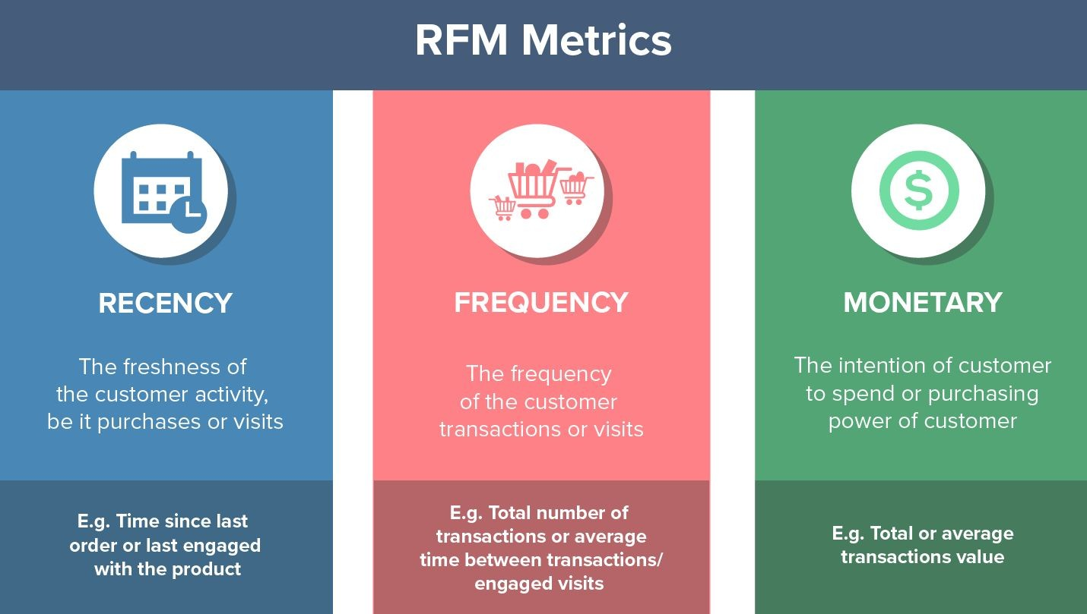
RFM MODEL
Created features such as recency, frequency and monetary

Slide 18
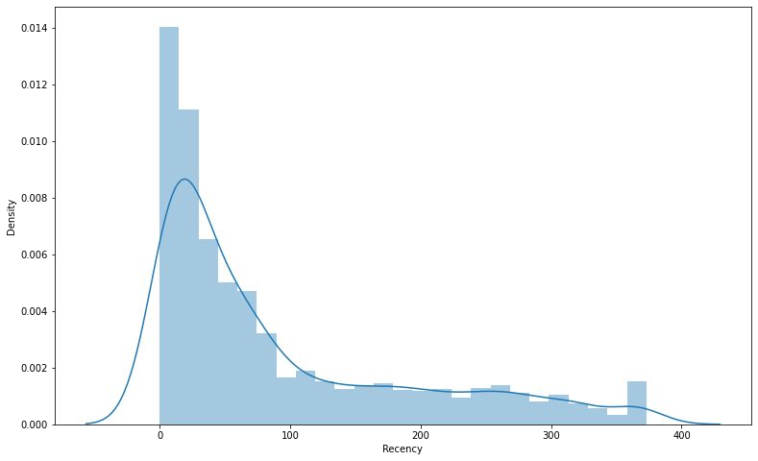
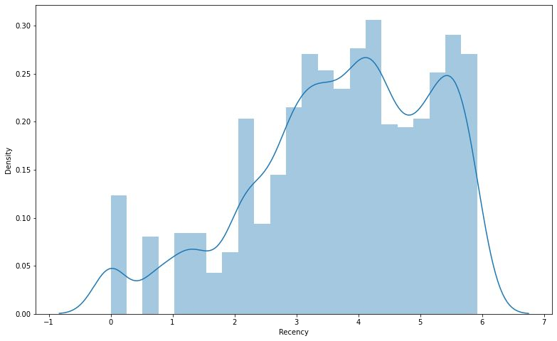
RECENCY

Slide 19
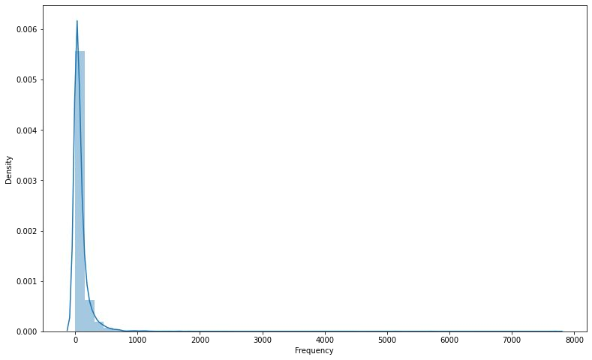
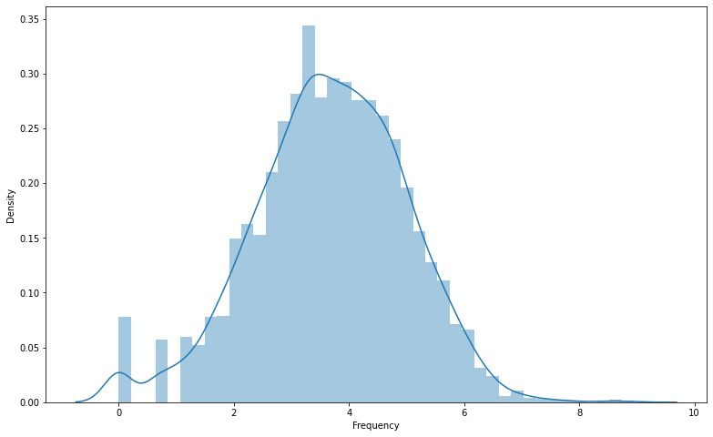
FREQUENCY

Slide 20
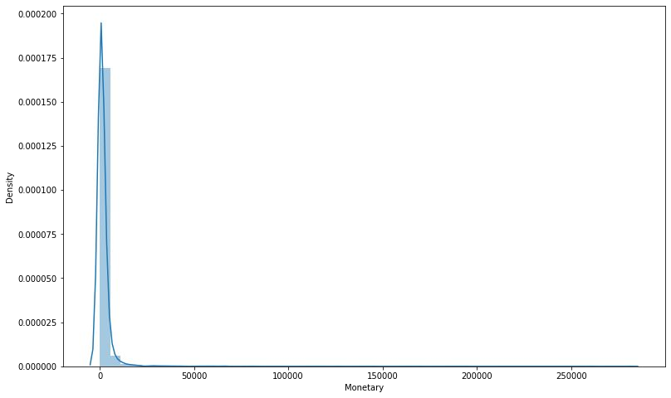
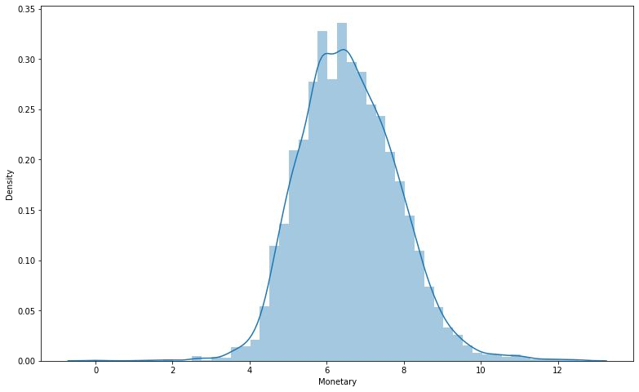
MONETARY

Slide 21
Calculation of Silhouette score
Silhouette score is used to evaluate the quality of clusters created using clustering algorithms such as K-Means in terms of how well samples are clustered with other samples that are similar to each other. The Silhouette score is calculated for each sample of different clusters. To calculate the Silhouette score for each observation/data point, the following distances need to be found out for each observations belonging to all the clusters:
Mean distance between the observation and all other data points in the same cluster. This distance can also be called a mean intra-cluster distance. The mean distance is denoted by a.
Mean distance between the observation and all other data points of the next nearest cluster. This distance can also be called a mean nearest-cluster distance. The mean distance is denoted by b.
The Silhouette Coefficient for a sample is S=(b−a)max(a,b).

Slide 22
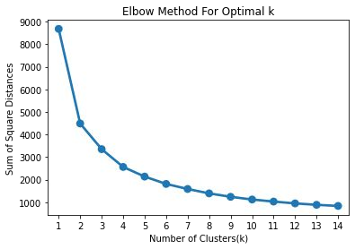
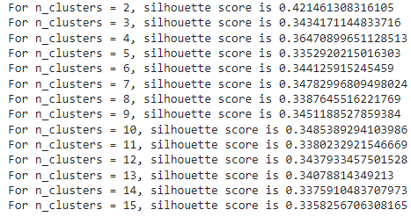
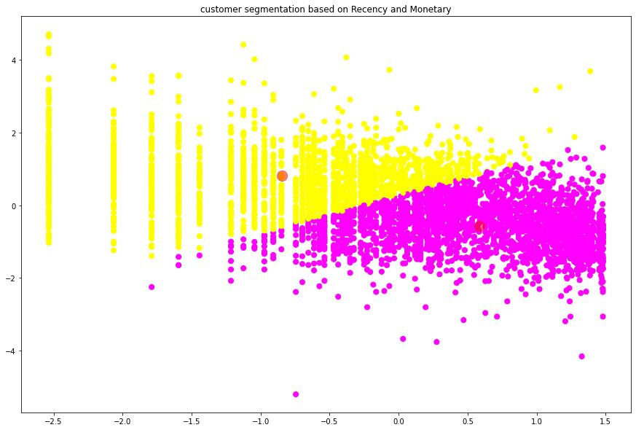
SILHOUETTE SCORE AND ELBOW METHOD ON R&M

Slide 23
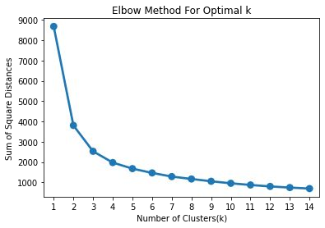
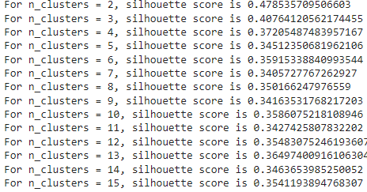
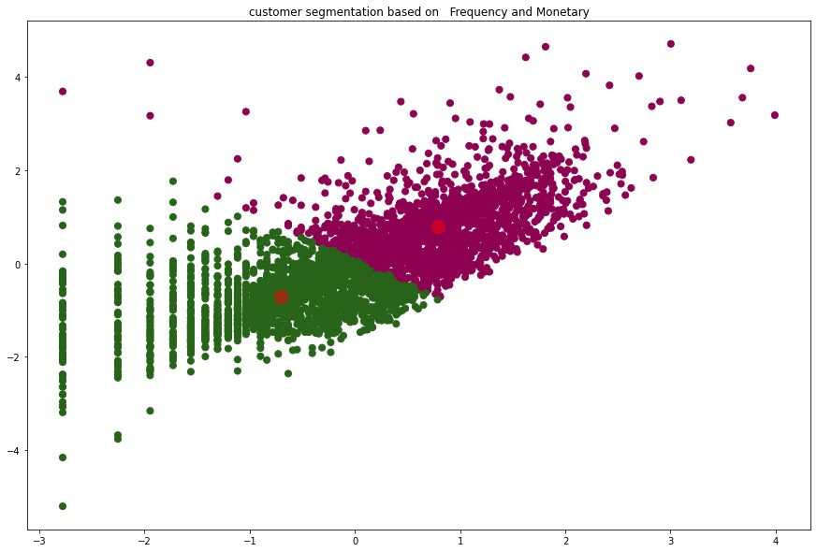
SILHOUETTE SCORE AND ELBOW METHOD ON F&M

Slide 24
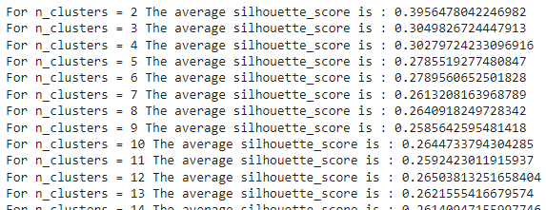
SILHOUETTE ANALYSIS ON R, F AND M

Slide 25
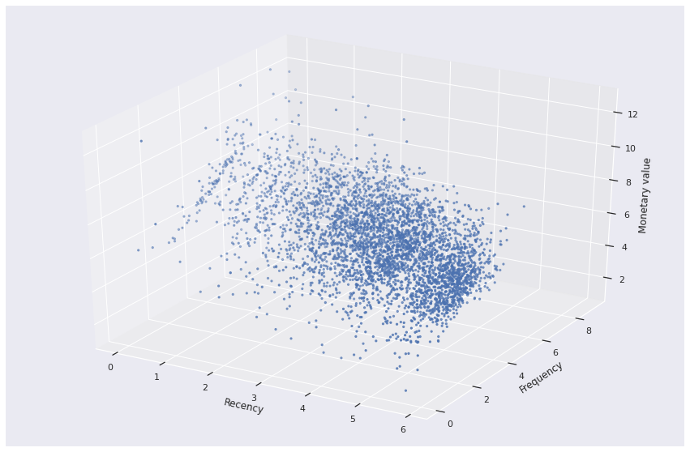
3D visualization of Recency Frequency and Monetary

Slide 26
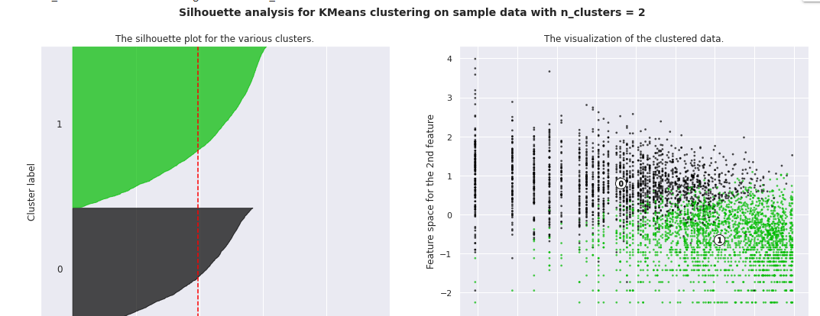
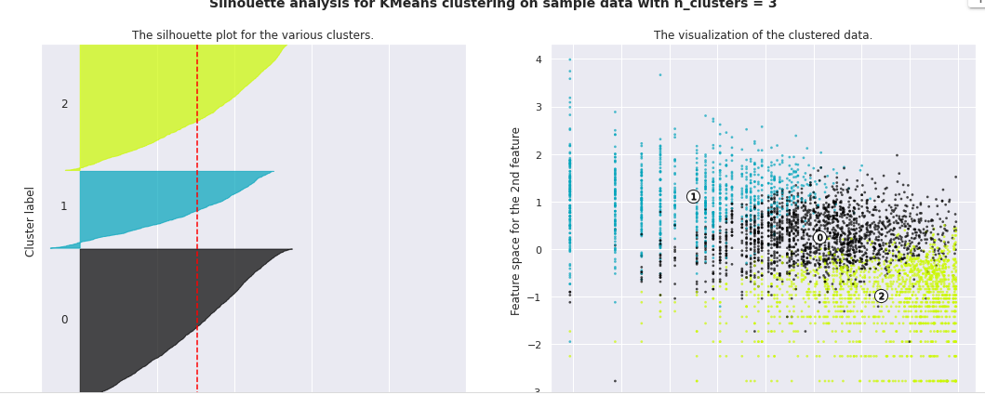
SILHOUETTE ANALYSIS ON R, F AND M

Slide 27
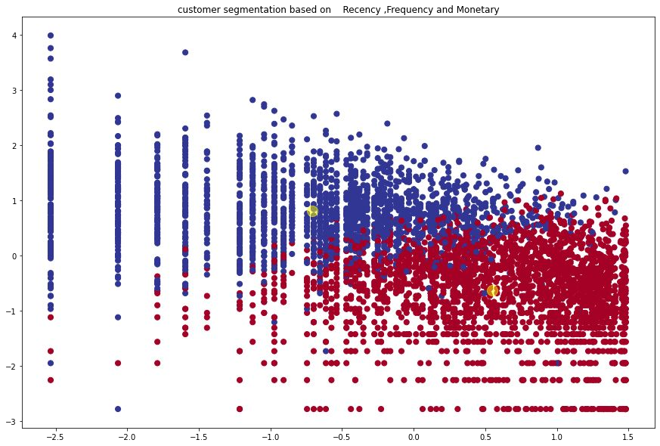
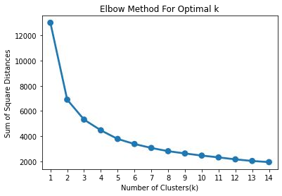
ELBOW METHOD AND CLUSTER CHART ON RFM

Slide 28
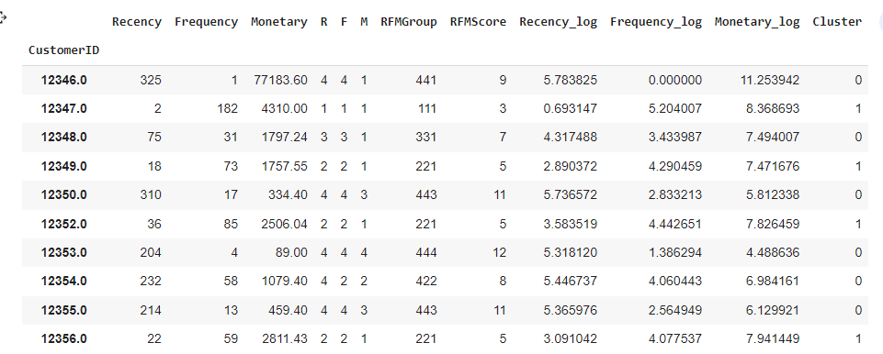
RFM ANALYSIS

Slide 29
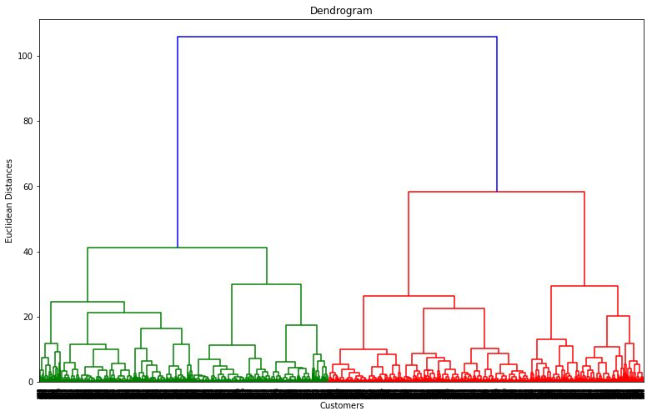
HIERARCHICAL CLUSTERING
The number of clusters will be the number of vertical lines which are being intersected by the line drawn using the threshold=90
No. of Cluster = 2

Slide 30
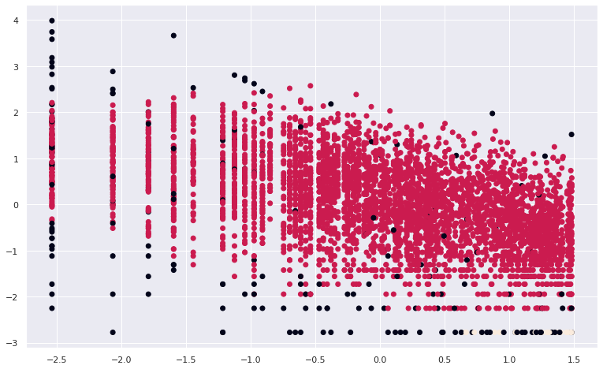
DBSCAN TO RECENCY ,FREQUENCY AND MONETARY
Density-based spatial clustering of applications with noise (DBSCAN)
we see that ,Customers are well separate when we cluster them by Recency ,Frequency and Monetary and optimal number of cluster is equal to 3

Slide 31
CHALLENGES
Large Dataset to handle.
Needs to plot lot of Graphs to analyse.
Lot of NaN values.
Continuous Runtime and RAM Crash due to large dataset.
Right number of ‘K’ for clusters

Slide 32
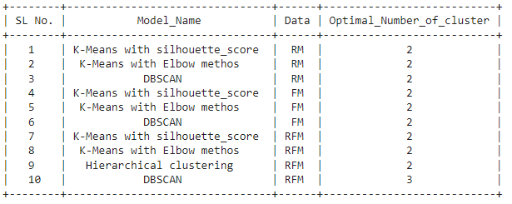

Slide 33
CONCLUSION
Throughout the analysis we went through various steps to perform customer segmentation. We started with data wrangling in which we tried to handle null values, duplicates and performed feature modiﬁcations. Next we did some exploratory data analysis and tried to draw observations from the features we had in the dataset.
Next we formulated some quantitative factors such as recency, frequency and monetary known as rfm model for each of the customers. We implemented K-Means clustering algorithm on these features. We also performed silhouette and elbow method analysis to determine the optimal no. of clusters which was 2.
We saw customers having high recency and low frequency and monetary values were part of one cluster and customers having low recency and high frequency, monetary values were part of another cluster.
We saw higher values of frequency, monetary and low values of recency is deciding one class and low values of frequency, monetary and high values of recency is deciding other class.

Slide 34
Q & A

Slide 35
THANK YOU

